Slide 1
Process/Threads Synchronization and Deadlocks
Module 9
ITSC205
Operating Systems Internals

Slide 2
Module Objectives
Describe and compare process synchronization mechanisms.
Compare synchronization techniques in Unix systems
Explain inter-process communication mechanisms (IPC).
Analyze the structure of shared libraries/DLL.
Confirm the presence of deadlocks.
Evaluate techniques used to handle deadlock.

Slide 3
Problem: Race Condition
A situation where processes/threads are “racing” to change share data/code at the same time. The area where the shared data/code is located is known as critical section (CS). Outcome depends on the order process/threads are scheduled for execution
Shared data is accessed (read) and manipulated (write) by multiple threads
Multithreding – Concurrency

Slide 4
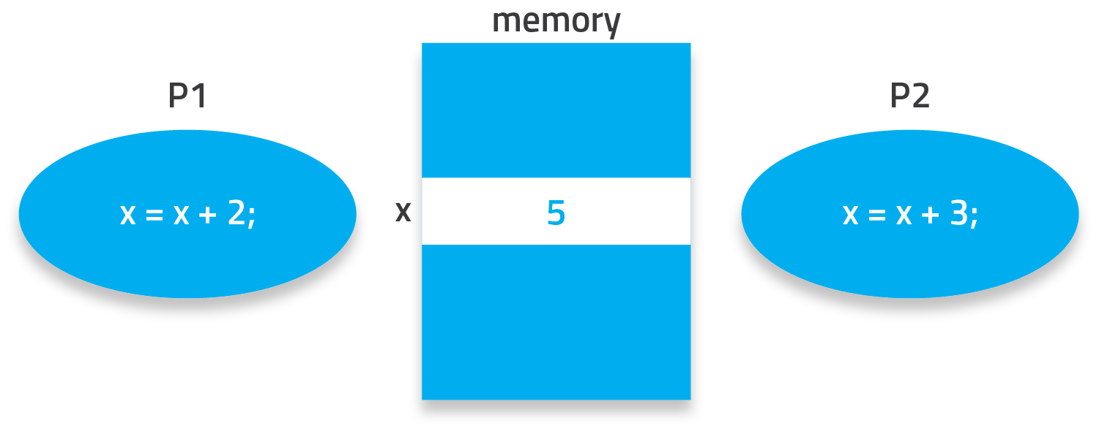
Critical Sections
Is a section of code in a program that contains a set of shared variables.
Notes:
P1 needs to add 2 to X
P2 needs to add 3 to X
P1 reads X (5)
P2 reads X (5)
P1 adds 2 to X and stores 7
P2 adds 3 to X and stores 8
Should X be 7, 8 or 10?

Slide 5
Critical Section
while(true){
Entry Section
critical section
Exit Section
remainder section
}
Notes:
Each process gets a turn at the critical section and must request permission to enter to it.
If a process wants the critical section, it sets its flag and may have to wait for its turn .
Entry section: used to negotiate entry into the critical section
Exit section: advises that the process has finished executing in its critical section.
Before entering its critical region each process calls enter region with its own process number 0 or 1 as parameter. This call will cause it to wait (loop), if necessary, until it is safe to enter . After it has finished with the shared variables , the process calls leave region to indicate that is done and allow other process to enter.

Slide 6
Threads Problem
Threaded programs are programs that run concurrently
In particular, there’s no way to know when the system will schedule one thread to run and when it will run another.
One thread might run for a very long time, or the system might switch among threads very quickly.
On a system with multiple processors, the system might even schedule multiple threads to run at literally the same time.
There’s no way to make the system schedule the threads exactly the same way it did before.

Slide 7
Threads and Race Condition
Often, buggy threaded programs contain a code that will work only if one thread gets scheduled more often—or sooner—than another thread.
These bugs are called race conditions; the threads are racing one another to change the same data structure.

Slide 8
Solution: Synchronization
Only one Process/Thread can execute its critical section at any given time
Must ask for permission to enter its critical section (CS)
Permission is controlled by a lock
Locking of critical sections can be H/W or S/W or both
Check if it’s locked (another process is in its CS)
If it’s locked, wait
Otherwise, set the lock and execute CS
Unlock
Notes:
Checking and setting the lock must be an ATOMIC operation – can not be interrupted! Why?

Slide 9
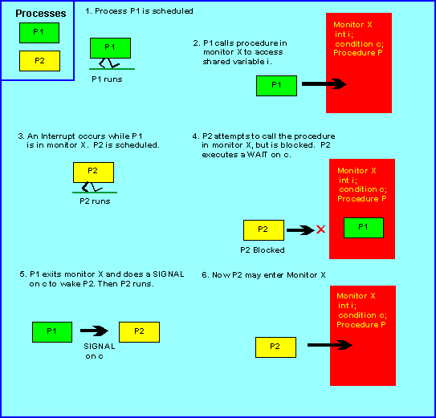
Synchronization

Slide 10
Synchronization Techniques -Locks
Semaphores
Binary
Counting
Mutex –Mutual Exclusion
Monitor
While waiting on a lock, a process can:
Busy-waiting (spinlock)
Block and go to the waiting state
Notes:
Why would we choose to spinlock instead of blocking?

Slide 11
Hardware Support
Test-and-Set :is a single indivisible (atomic) machine instruction (TS).
An atomic Test-and-Set operation. Both operations must be performed in a single machine cycle
Not subject to interference from other instructions
If the Test-and-Set returns one, the calling thread owns the resource. If it returns zero, the resource is locked by another thread
Busy waiting - A Process is always checking to see if it can enter the critical section
A Process can do nothing productive until it gets permission to enter its critical section

Slide 12
Semaphores
Semaphores control access to share resources by processes in a concurrent system
Wait and Signal operations cannot be interrupted (atomic)
Wait operation decrements the semaphore value. ( P(s) proberen)
Signal operation increments semaphore value. (V(s) verhogen)
Notes:
A signaling semaphore (S) is one that usually is initialized to 0. A process signals an event by executing V(s) . Other process Wait for that event by executing P(s)
To overcome the need for busy waiting, we can use Wait and Signal operations. When a process executes the wait operation and find that the value of the semaphore is zero, it must wait. However, rather than busy waiting, the process can block itself. The block operation places a process into a wait queue associated with the semaphore and the state of the process is changed to the waiting state. Then control is transferred to the CPU scheduler.
A process that is blocked ,Waiting on a semaphore S, should be restarted when some other process executes a Signal operation. A signal operation removes one process from the list of waiting processes and awakens that process.
For the critical region problem, we need to use only one semaphore as a lock, because the only concern is whether a process is inside or outside its critical region.
The critical aspect of semaphores is that they are executed atomically. We must guarantee that no two processes can execute Wait and Signal operations on the same semaphore at the same time.
There are Binary semaphores.( use only 0 and 1) and Counting semaphores (range of non-negative values)

Slide 13
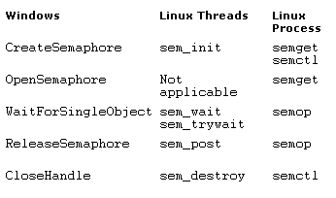
Semaphore System calls

Slide 14
Semaphores disadvantages
Semaphores provide atomicity and blocking mechanisms, on a multiprocessor system this does not guarantee Mutex
Blocking and unblocking require context switches and manipulation of sleep and scheduler queues, which make the operations slow
Notes:
The atomicity problem can be solved in a uni-processor by inhibiting interrupts during the time the wait and signal operations are executing, but this technique does not work in multiprocessor systems.
The implementation of semaphores with a waiting queue may result in:
Deadlock – two or more processes are waiting indefinitely for an event that can be caused by only one of the waiting processes.
Starvation – indefinite blocking. A process may never be removed from the semaphore queue in which it is suspended

Slide 15
Linux Synchronization
Linux:
Prior to kernel Version 2.6, disables interrupts to implement short critical sections
Version 2.6 and later, kernel fully preemptive
Linux provides:
Semaphores
Spinlocks It is a scalar variable (0 =available 1= locked)
If a resource is protected by spin lock, a thread trying to acquire the resource will busy –wait until the resource is unlocked
reader-writer versions
Condition variable
On single-CPU system, spinlocks replaced by enabling and disabling kernel preemption

Slide 16
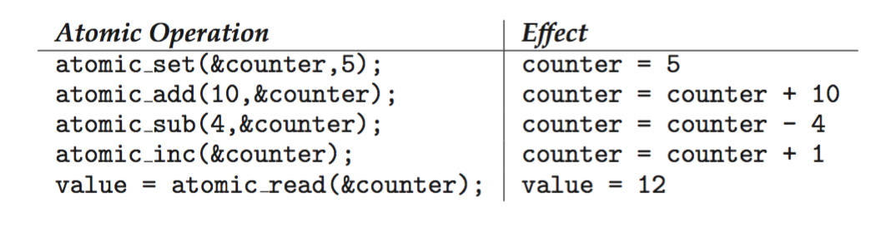
Linux Synchronization
Atomic variables atomic_t is the type for atomic integer
Consider the variables atomic_t counter; int value;

Slide 17
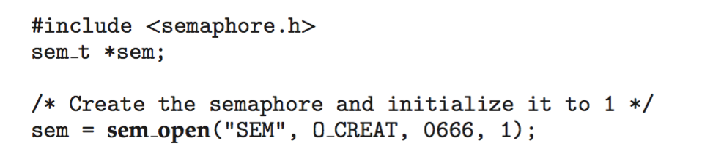
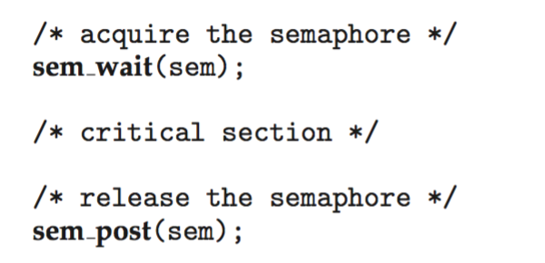
POSIX Named Semaphores
Creating an initializing the semaphore:
Another process can access the semaphore by referring to its name SEM.
Acquiring and releasing the semaphore:

Slide 18
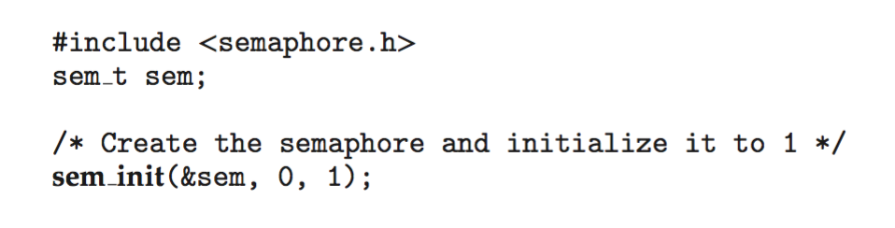
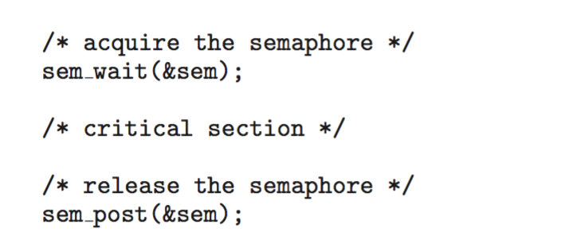
POSIX Unnamed Semaphores
Creating an initializing the semaphore:
Acquiring and releasing the semaphore:

Slide 19
pthread_mutex_lock
Wait for and lock a mutex
#include <pthread.h>
Pthread_mutex_lock(pthread_mutex_t *mutex)
mutex is a pointer to mutual exclusion

Slide 20
pthread_mutex_unlock
#include <pthread.h>
Pthread_mutex_unlock(pthread_mutex_t *mutex)
mutex is a pointer to mutual exclusion

Slide 21
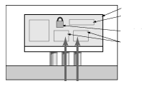
Threads synchronization with locks
One Process
One Counter
One lock
Two threads

Slide 22
Windows Synchronization
Uses interrupt masks to protect access to global resources on uniprocessor systems
Uses spinlocks on multiprocessor systems
Spinlocking-thread will never be preempted
Also provides dispatcher objects user-land which may act as mutexes, semaphores, events, and timers
Events
An event acts much like a condition variable
Timers notify one or more thread when time expired
Dispatcher objects either signaled-state (object available) or non-signaled state (thread will block)

Slide 23
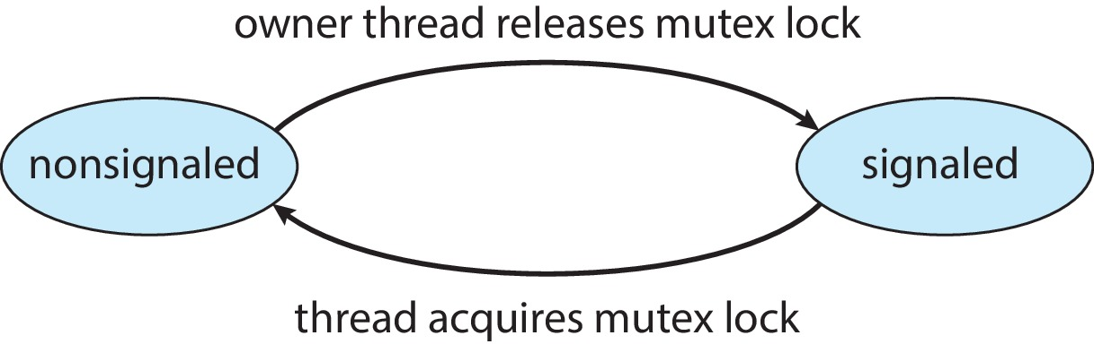
Kernel Synchronization - Windows
Mutex dispatcher object

Slide 24
Summary
Define Synchronization
Define race condition and critical section
Describe techniques to solve synchronization problems
Use POSIX Threads to synchronize threads

Slide 25
Inter-process Communication (IPC)
OS provides mechanism for processes to share data
Without interrupts (i.e. not interfere with execution)
Both local and remote (across different machines)
Basic transfer modes – require synchronization
Shared memory
Message passing

Slide 26
Shared Memory
Processes read and write data from/to the shared memory segment by calling the
strcpy( ptr, “data”)
Shared memory technique has race condition problem. A client reads memory segment while the server is writing a string to the segment, then the client reads wrong data.
To avoid race condition any synchronization technique can be used. The most common is semaphores
Linux command: ipcs –a or ipcs -s

Slide 27
Shared Memory
Section of memory that can be accessed by multiple processes
For communication or sharing data
Basic model for multi-threaded processes
Avoid duplicate copies and use less memory overall
Shared libraries -DLLs
Fast but not scalable
Must make sure processes don’t overwrite others’ data
Processes must be executing on the same machine
Notes:
The Producer-consumer problem.

Slide 28
Shared Memory in Practice
Shared libraries or Dynamic-link libraries (DLLs)
Shared code, designed to be used by other processes
Can be simple modules or executables
Must have a symbol table
Every identifier is pointed to its location in memory
Used for debugging and dumps
May contain symbol names, type, scope and address, E.g.
T = text (code), A = absolute, D = initialized data
Lowercase = local, uppercase = global
Notes:
We’ll discuss the “dynamic-link” part in the memory management modules… for now, it’s the same thing as “shared”.
GNU nm - https://sourceware.org/binutils/docs-2.17/binutils/nm.html#nm
DLL hijacking

Slide 29
Message Passing
Processes exchanges messages to coordinate activities and share data
Higher overhead but no risk of overwrites and can be across different machines
Must be managed by the OS – mailboxes
Can be owned by a process or the OS
Send/receives messages via a mailbox
Synchronous or asynchronous
Messages must be queued

Slide 30
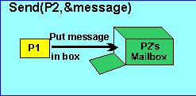
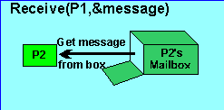
Indirect Communication
Notes:
The picture above illustrates the SEND and RECEIVE primitives used in message passing. SEND takes two arguments, the destination mailbox and the message. RECEIVE also takes two arguments, the ID of the sender, and the message.

Slide 31
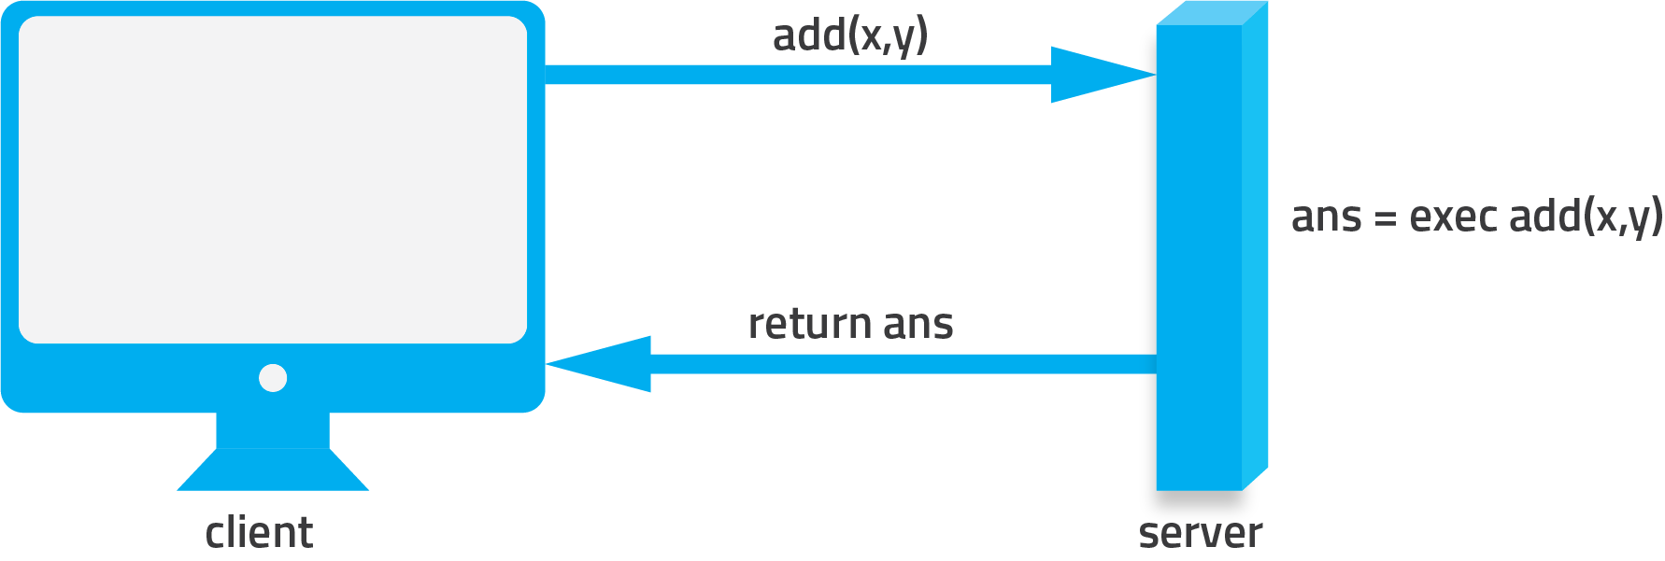
Message Passing in Practice
Sockets and Remote Procedure Call (RPC)

Slide 32
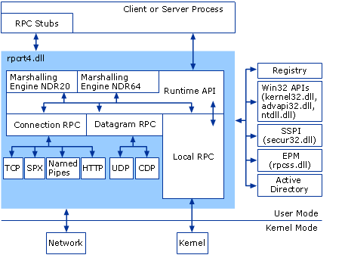
RPC –Remote Procedure Call
https://technet.microsoft.com/en-us/library/cc738291(v=ws.10).aspx

Slide 33
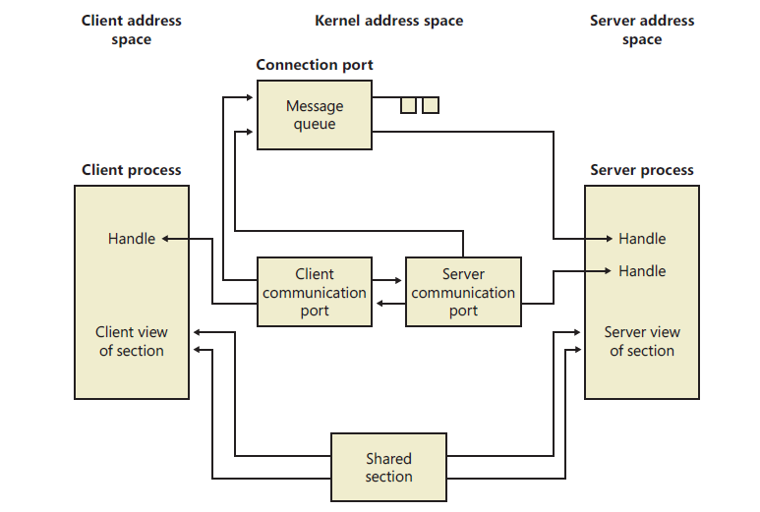
Windows ALPC

Slide 34
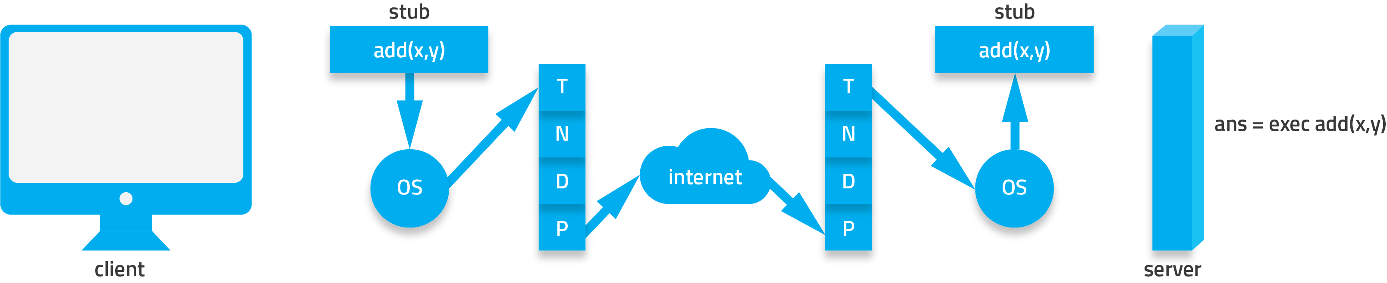
Request-Response Model

Slide 35
RPC

Slide 36
Process/Threads’ Resources
Finite amount of resources available in any system
Resource types
Physical: CPU, memory, hard drives etc.
Logical: files, semaphores, mutex, spinlocks, signals
Events: IPC
Instances of each type
E.g. Dual-core processor = 4 logical processors = 4 instances of CPU
Processes compete for system resources
Synchronization introduces even more competition

Slide 37
Resource Utilization
Processes exhibit a clear pattern of resource utilization
Request
Use
Release
Resources managed and tracked by OS
Process must wait if resource is unavailable
OS tracks waiting processes in device queues
OS will grant the request resource to the next process in the queue
Notes:
*next depends on the selection method.

Slide 38

The Dining Philosophers Problem

Slide 39
Process Deadlock
A set of processes is in a deadlock state when every process in the set is waiting for an event that can only be caused by another process in the same set.
Processes cannot continue execution as it is waiting indefinitely for a resource that will never be freed
In an interactive environment, users may witness programs that are “hung” (unresponsive)

Slide 40
Conditions for Deadlocks
Mutual Exclusion
Only one process can control one instance of a resource at a time (not sharable)
Hold and Wait
A process can hold a resource while waiting for another
No Preemption
A resource cannot be taken away from a process (OS has no control to pre-empt, only the process can release)
Circular Wait
Processes waiting for a resource held by another process in the same cycle

Slide 41
Resource Allocation Graph
Track resource usage and requests using a resource allocation graph
Circle labelled Pn for each process
Rectangle labelled Rn for each resource with solid dot for each instance
Arrows
for each resource allocation request: from P to R
for each resource instance allocated: from R to P
Provides a snapshot of the system at a moment in time

Slide 42
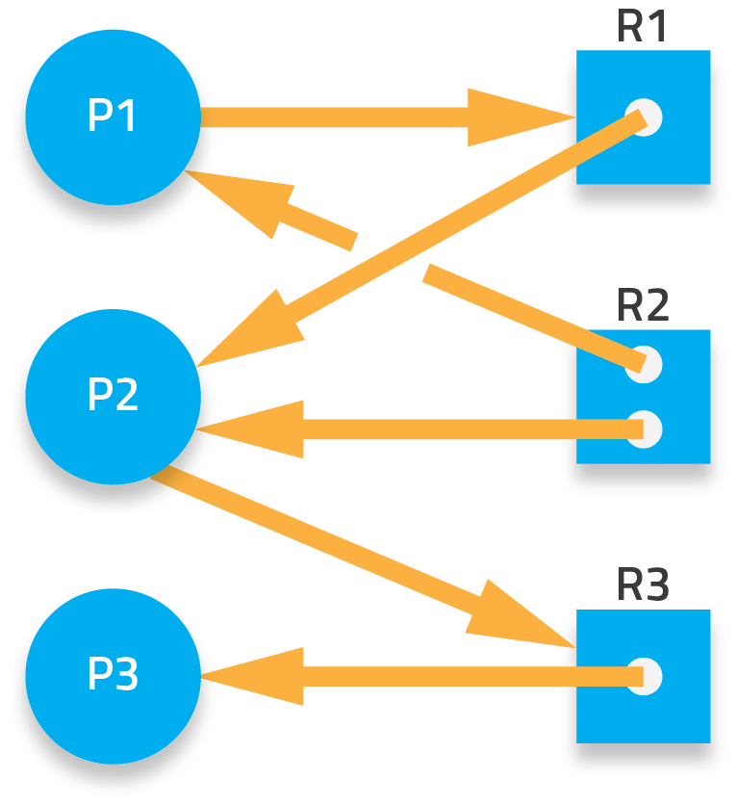
Resource Allocation Graph
Notes:
A simple system with 3 processes and 3 types of resources, R1 and R3 each has one instance, R2 has 2 instances.
R1 allocated to P2, R3 allocated to P3, R2 allocated to P1 and P2.
P1 requests R1 and P2 requests R3.

Slide 43
Determining the Deadlock State
Draw the resource allocation graph
Check each process resource request and allocation. Check for a cycle (i.e. arrows will lead you back to the starting process)
P1 → R1 → P2 → R3 → P3
P2 → R3 → P3
P3 (not waiting for any resources)
Rule #1: no cycles = no deadlocks! , but not always a cycle means deadlock. It could be unsaved system it depends on resources instances availability and request

Slide 44
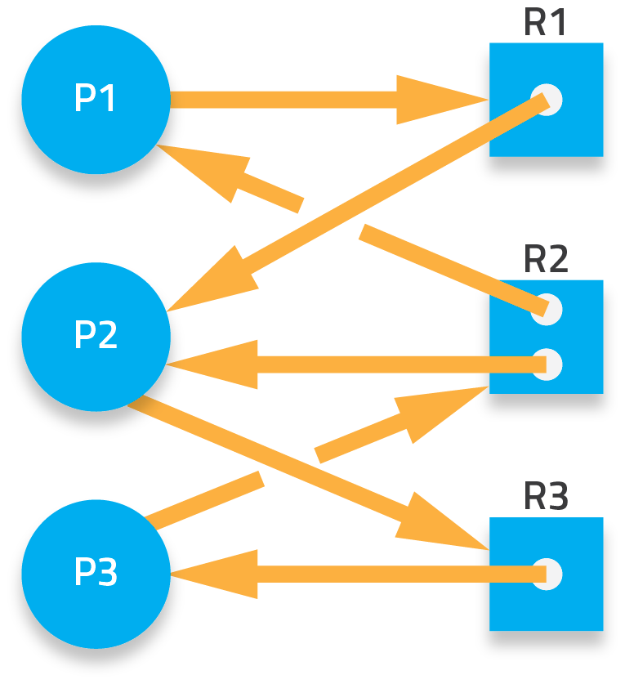
Determining the Deadlock State
Notes:
Using the same system, what happens if P3 also makes a request to R2?

Slide 45
Determining the Deadlock State
Again, check each process:
P1 → R1 → P2 → R3 → P3 → R2 → P1
P2 → R3 → P3 → R2 → P2
P3 → R2 → P2 → R3 → P3
Rule #2: cycles = MAYBE deadlocked! Must check ALL processes – if a set of processes are all waiting on a resource that is held by another process in the set then we have a deadlock!

Slide 46
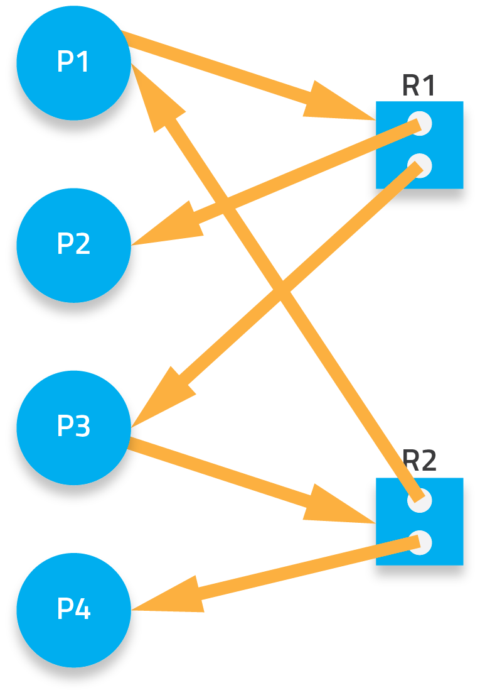
Determining the Deadlock State
Notes:
Let’s try a different system and snapshot…

Slide 47
Determining the Deadlock State
Checking the processes will show that there is a cycle but recall rule #2…
Is all the resources being held by processes in the cycle?
Keep in mind this shows us a snapshot in time, we need to consider what could happen at a later point in time
P2 or P4 can release their resource then P1 or P3 will be granted the resource and can proceed with execution!
Therefore, no deadlock!

Slide 48
Deadlock Handling
How should the OS handle deadlocks?
Prevention
Ensure the system can never enter a deadlock state
Avoidance
Track the possible development of deadlocks and avoid it
Detection and Recovery
Allow deadlocks to occur but provide mechanisms to detect the presence of a deadlock and strategies to recover from it
Ignore it!
In some systems, the cost and overhead outweighs the need to handle deadlocks

Slide 49
References
Operating System Concepts. Silberschatz, Galvin, Gagne. Latest edition. John Wiley & Sons.

